Slide 1
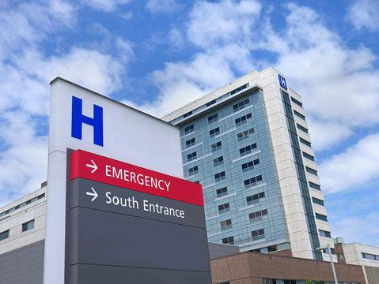
How to Get Healthcare Without Going Broke
By Iliya Voytsyshyn and Clive Smith

Slide 2
About the project creators
Clive Smith is a second year Biological Sciences major
Iliya Voytsyshyn is a second year Genetics major

Slide 3

A bit about the data…
First data set
Hospital admission data with 6 common conditions and 5 insurance providers
Second data set
Hospital location data, with latitude, longitude, ZIP code, etc…

Slide 4

Project Overview
Our goal was to see which hospitals in the US provide the best care.
We used one dataset to evaluate the quality of each hospital, and another for the locations of the hospitals.

Slide 5
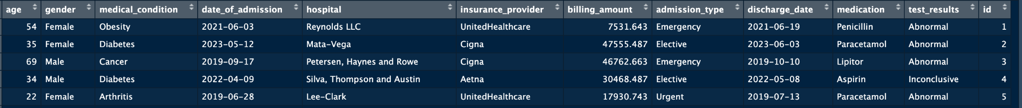
Cleaning the Data
In the main data set, we removed unnecessary variables, and changed the patient names into numbers.
In the locations data set, we removed all unnecessary variables and replaced the missing values with NAs

Slide 6
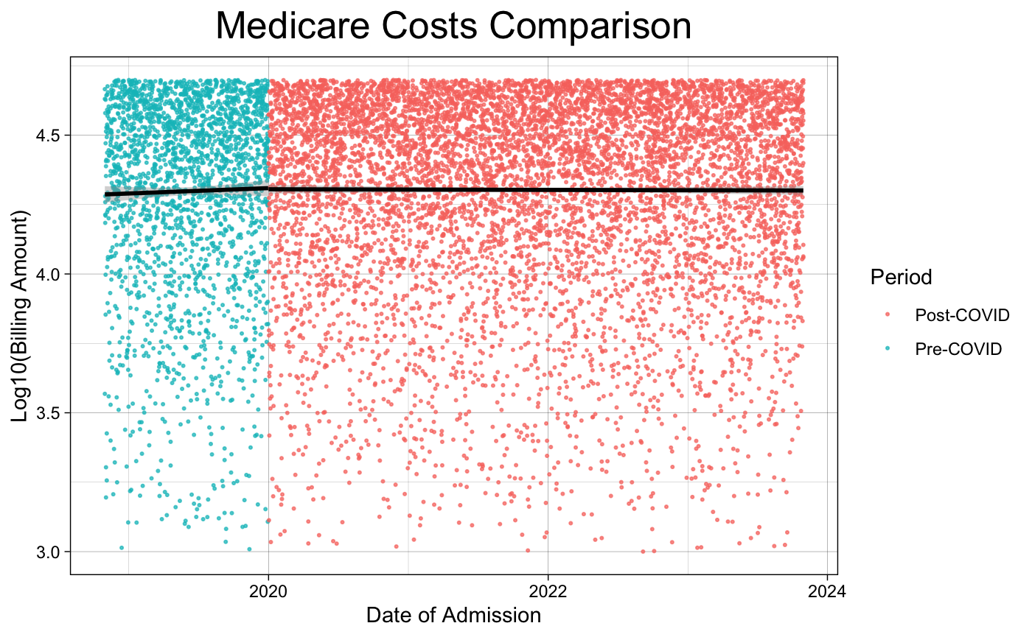
Analysis

Slide 7
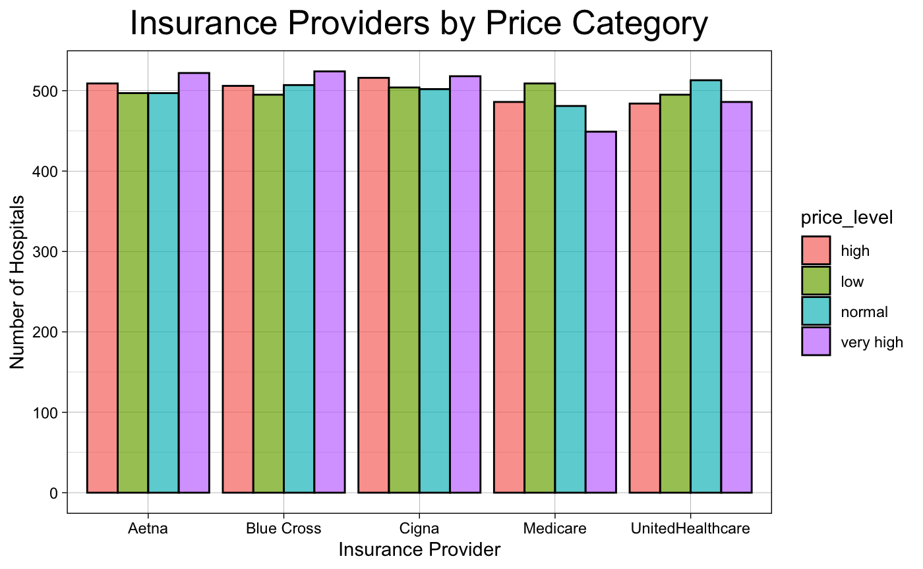
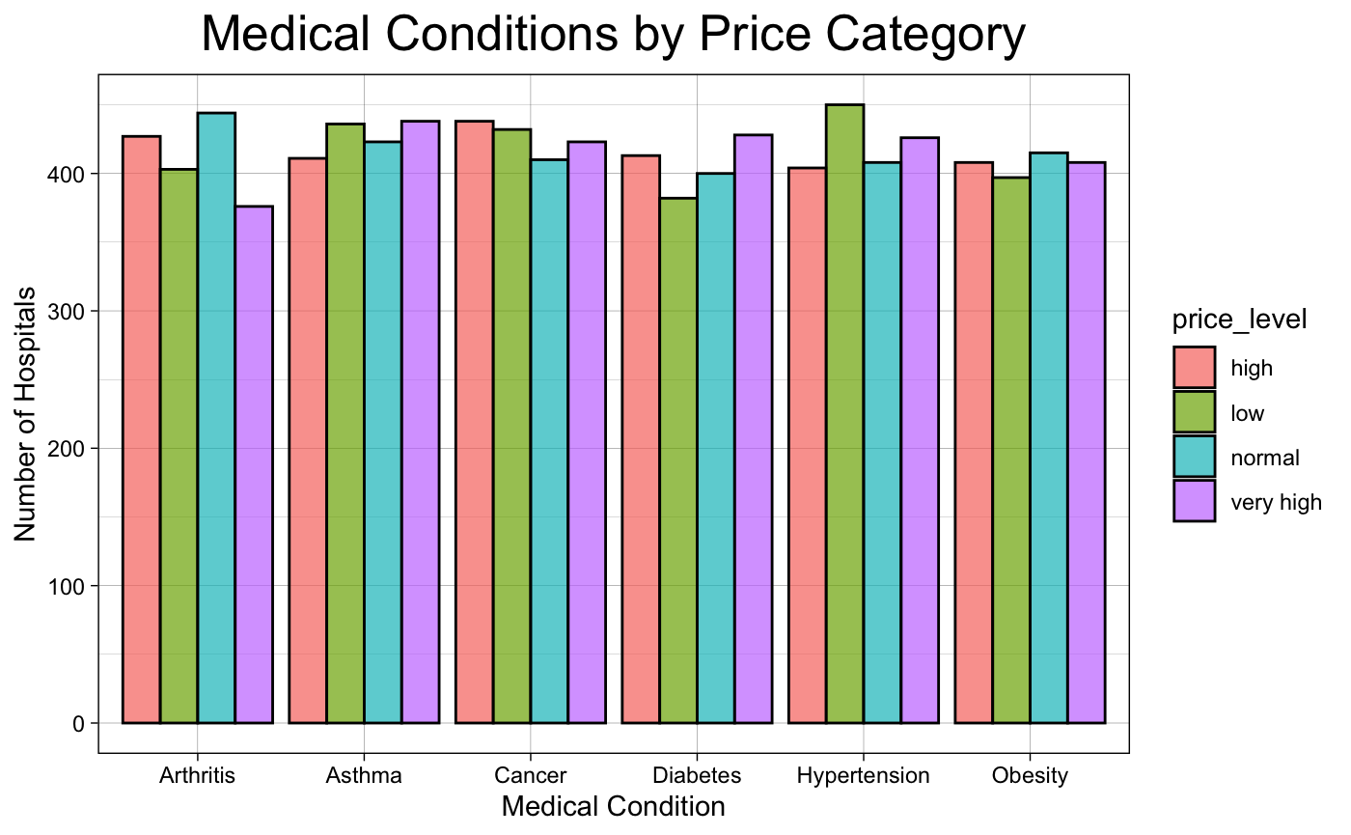
Some More Analysis

Slide 8
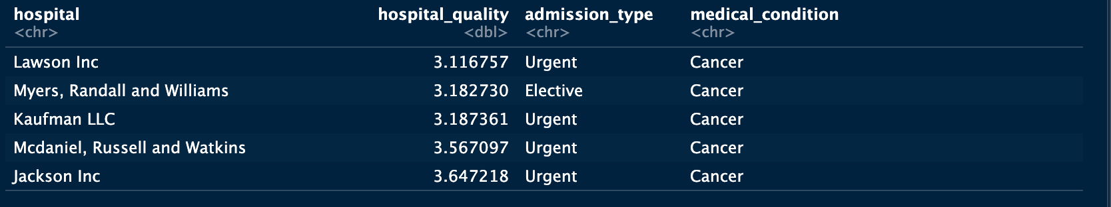
Setup for the app
Multiply billing amount and length of stay to get hospital quality value–lower value indicates higher quality

Slide 9
And now…to the app!

